Slide 1


Facilities Committee
Cerro Coso Community College
Presented By: Cody Pauxtis
Director of Maintenance and Operations

Slide 2
Upcoming M&O Projects
Baseball outfield fence repairs
Fine Arts: Air and Gas line
Welding and Furniture – June 2022
Observatory electrical and storage
Welding Lab: utilities for cutting table
CDC Fencing repairs – Completing warranty repairs
CDC Shade Structures – Awaiting vendor job walk
Warehouse Shelving

Slide 3

Facilities Committee Guidance
Committee review Facility project requests digitally twice a month, vice waiting for meetings.
Meetings are to discuss Project updates that are too much for emails. To review larger facility requests or to hear presentations on facility requests.
List action items for what needs to be go to Academic Senate, Classified Senate.
Committee members report back with feedback from Academic Senate and Classified Senate on any items that were needing to be presented.
Campus Life and Equity of the campuses: Committee members are the representatives for the constituency group they represent to bring issues or even compliments to the committee.

Slide 4
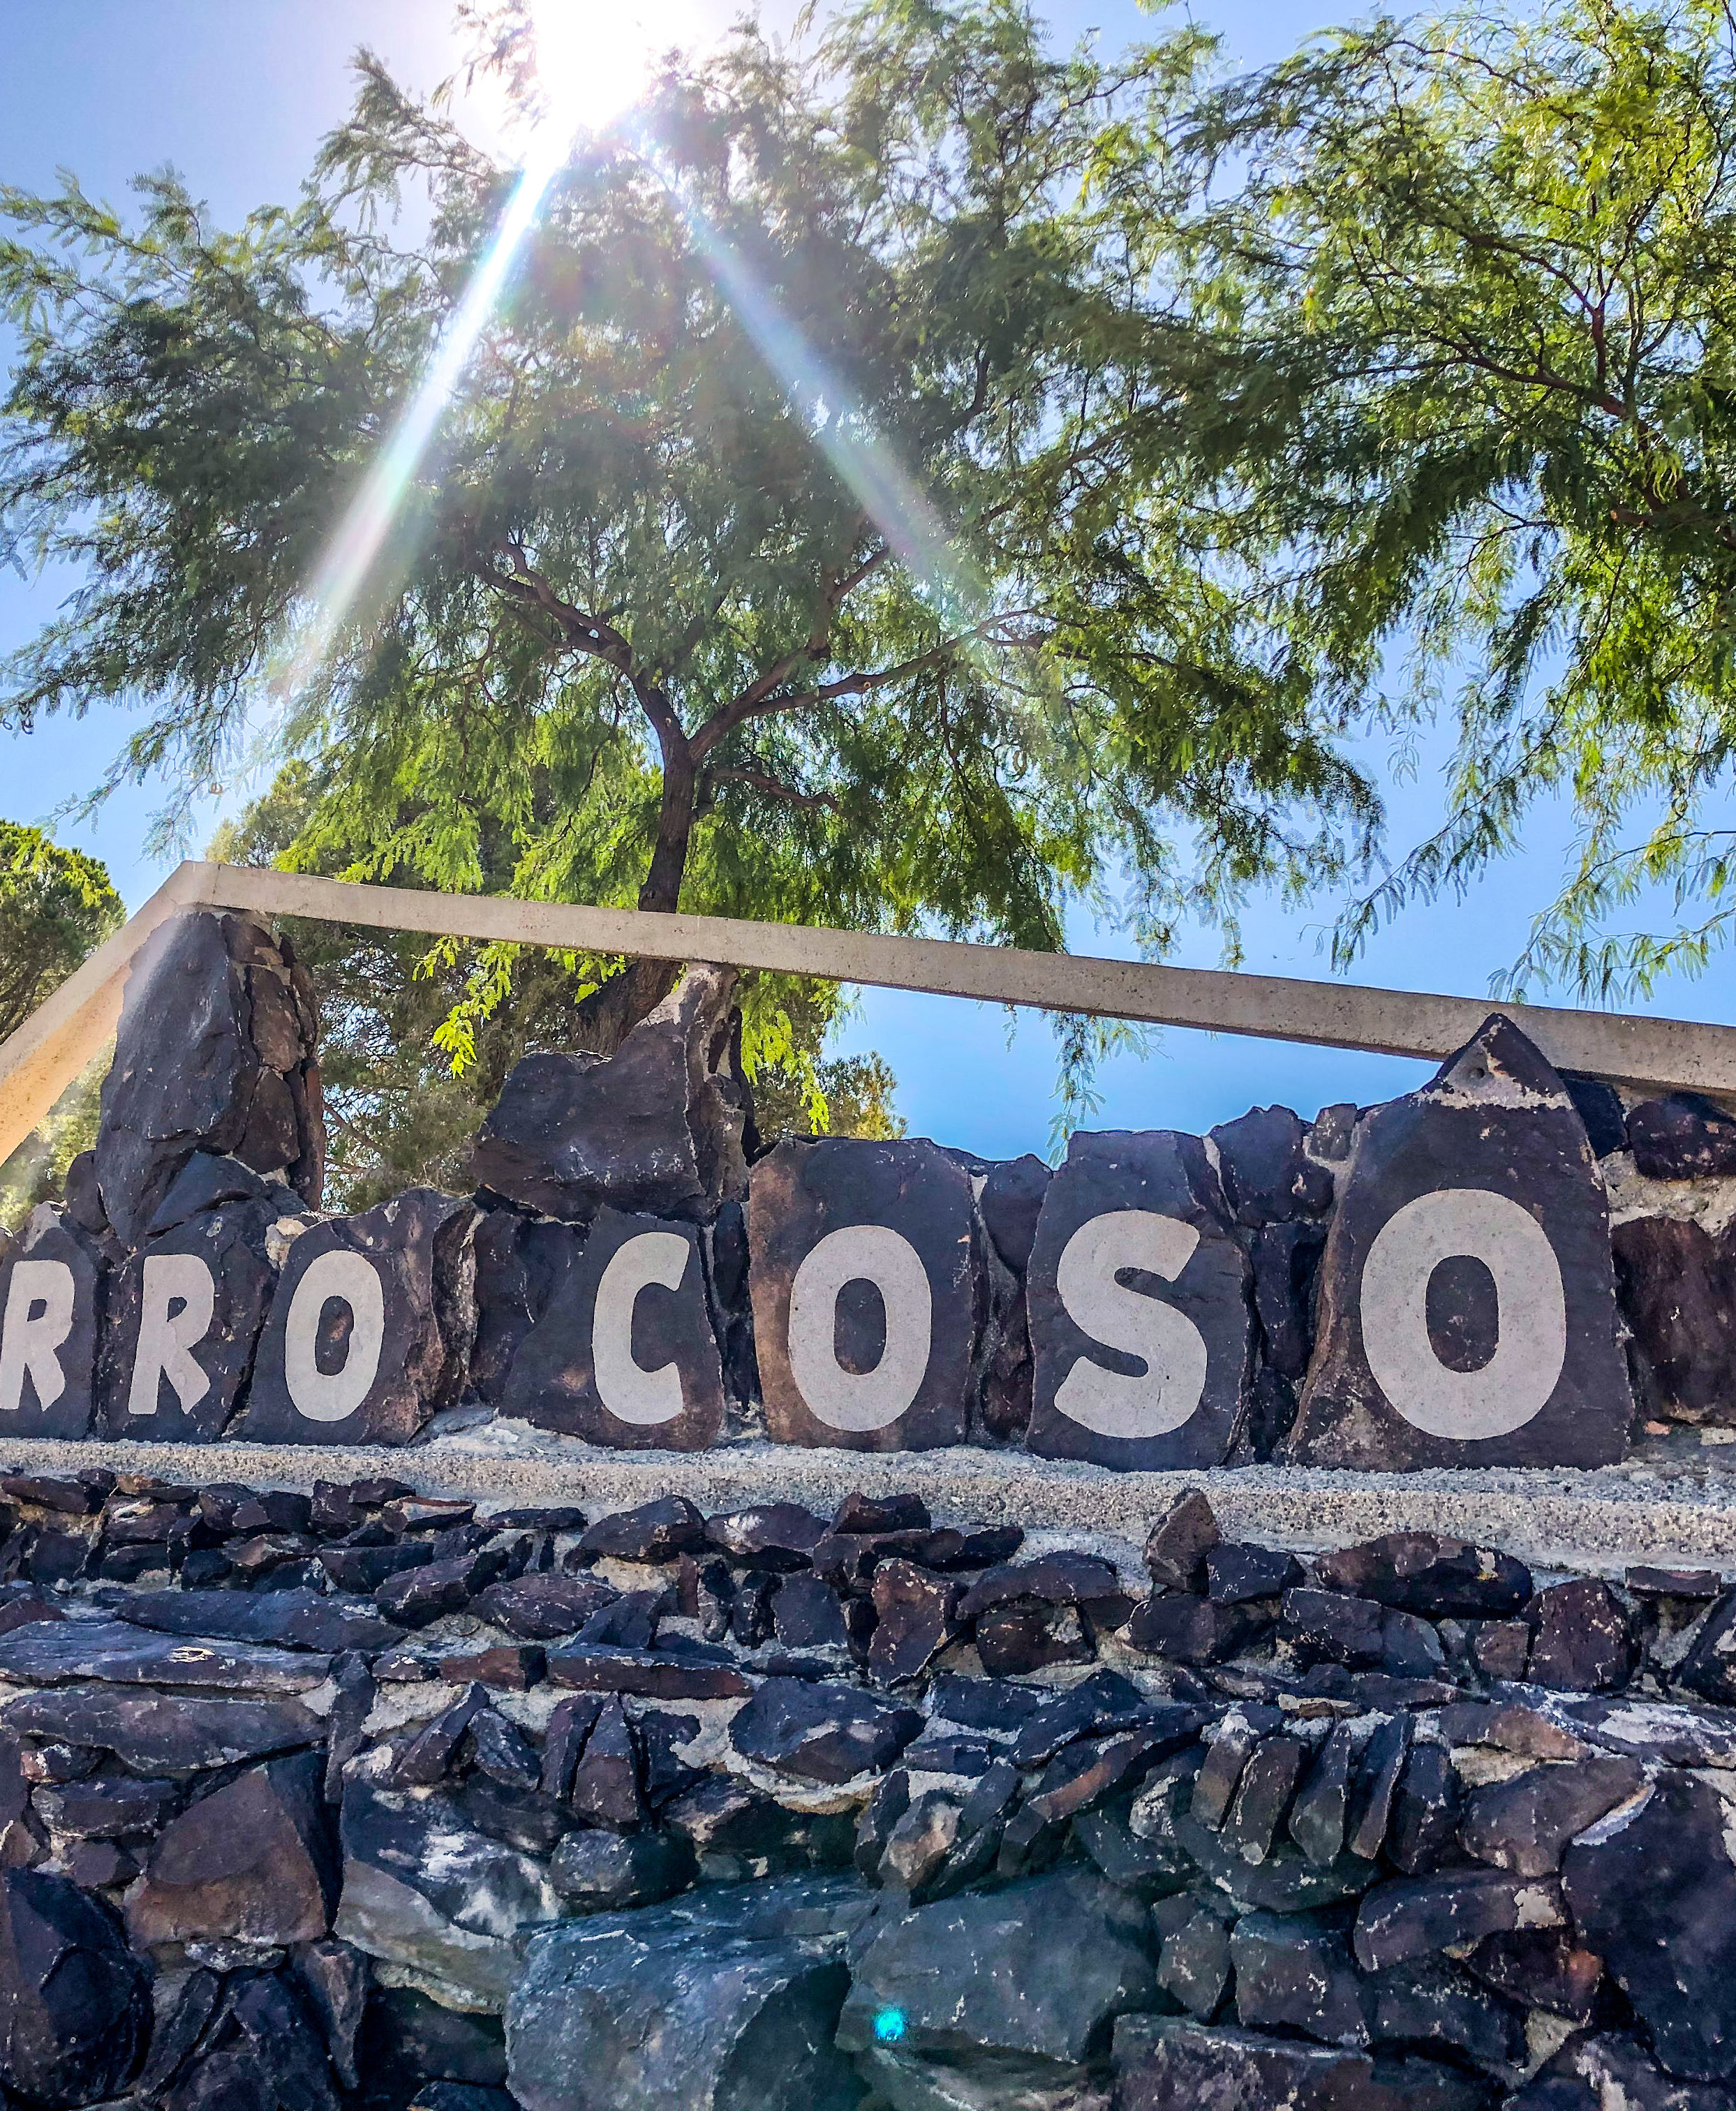
Measure J
Project Updates
Daniel Reed
Sports Complex
College Heights Blvd.
Gym Parking lot
SMSR Projects
  East wing air handlers
  Cal-City CDC Paint

